Slide 1
Can We Use Google Trends Search Data to Find Patterns in Bitcoin Trading?
April 4, 2018
Rupali, Sara, Scott, Seohong

Slide 2
Building a Bitcoin Sentiment Indicator Using Google Trends Data
Our hypothesis is that a spike in Google searches for “Bitcoin” combined with other specified search terms might indicate changing sentiment for Bitcoin
Negative search terms data was pulled from Google Trends using “Bitcoin” + the following terms: banned, scam, collapse, crash, fall, fraud, illegal, Ponzi, tulip, worst.
Positive search terms included: buy, coinbase, boom, binance.
The total volume of these negative searches was then divided by positive search terms to arrive at our theoretical bitcoin negative sentiment indicator (somewhat analogous to Vader sentiment for text)

Slide 3
Data Sources
Google Trends
Positive and Negative sentiment
https://trends.google.com/trends/
CryptoCompare API
Price and Volume
https://min-api.cryptocompare.com/data/histoday

Slide 4
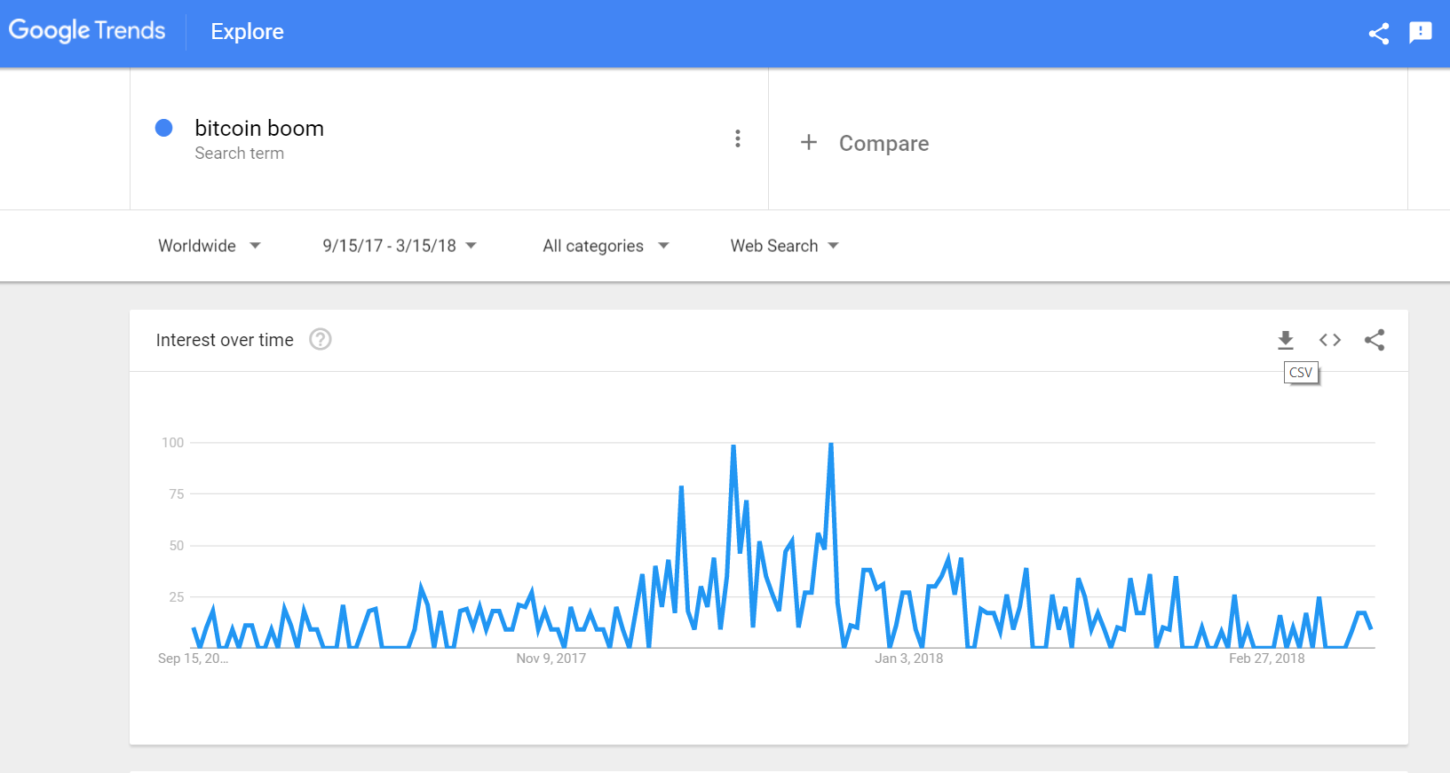
Data Exploration – Google Trends

Slide 5
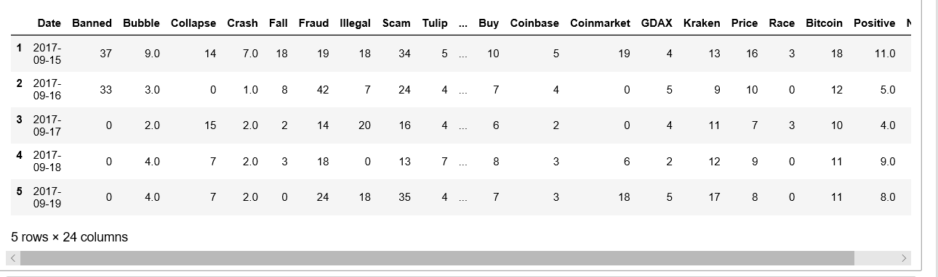
Google Trends Data Cleanup and Format

Slide 6
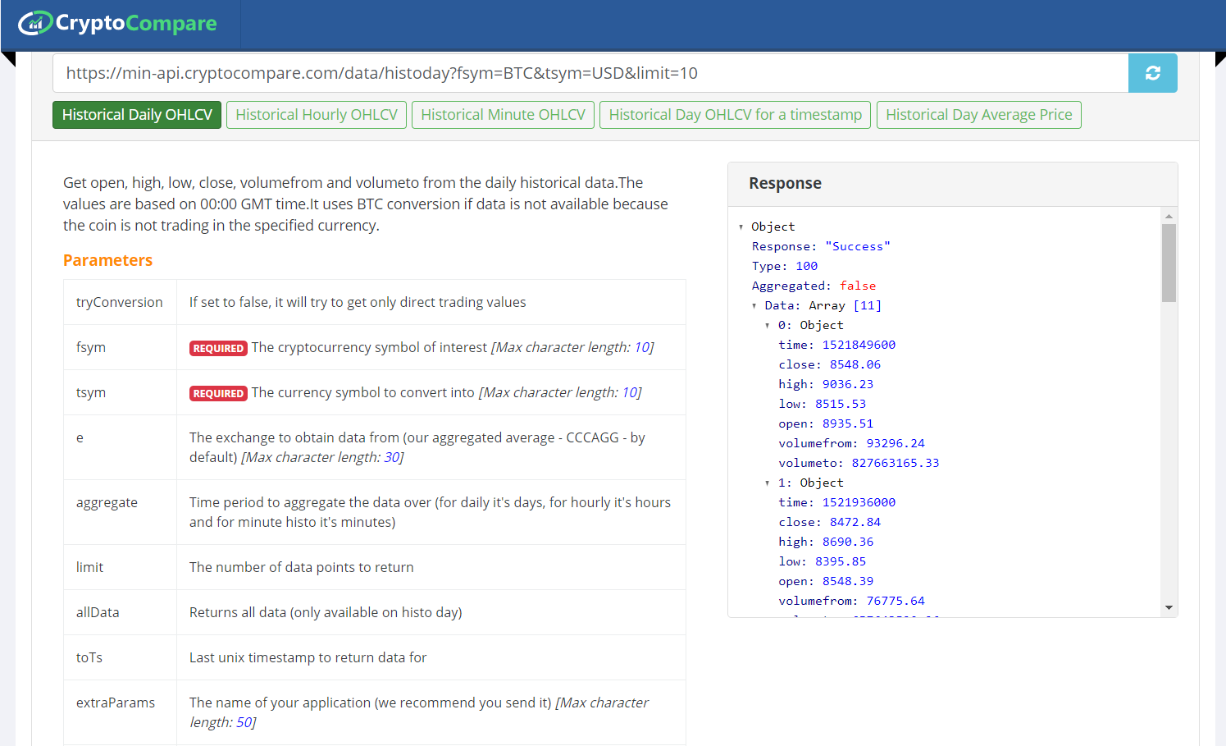
Data Exploration - CryptoCompare

Slide 7
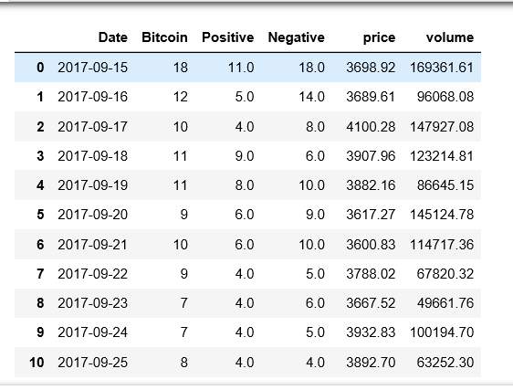
Final Dataset

Slide 8
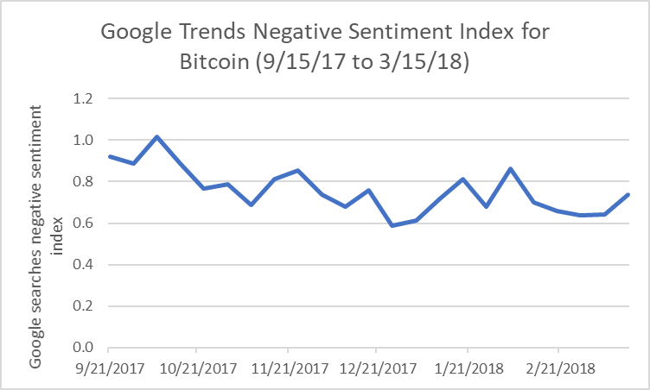
Google Trends Negative Sentiment Index -- Results

Slide 9
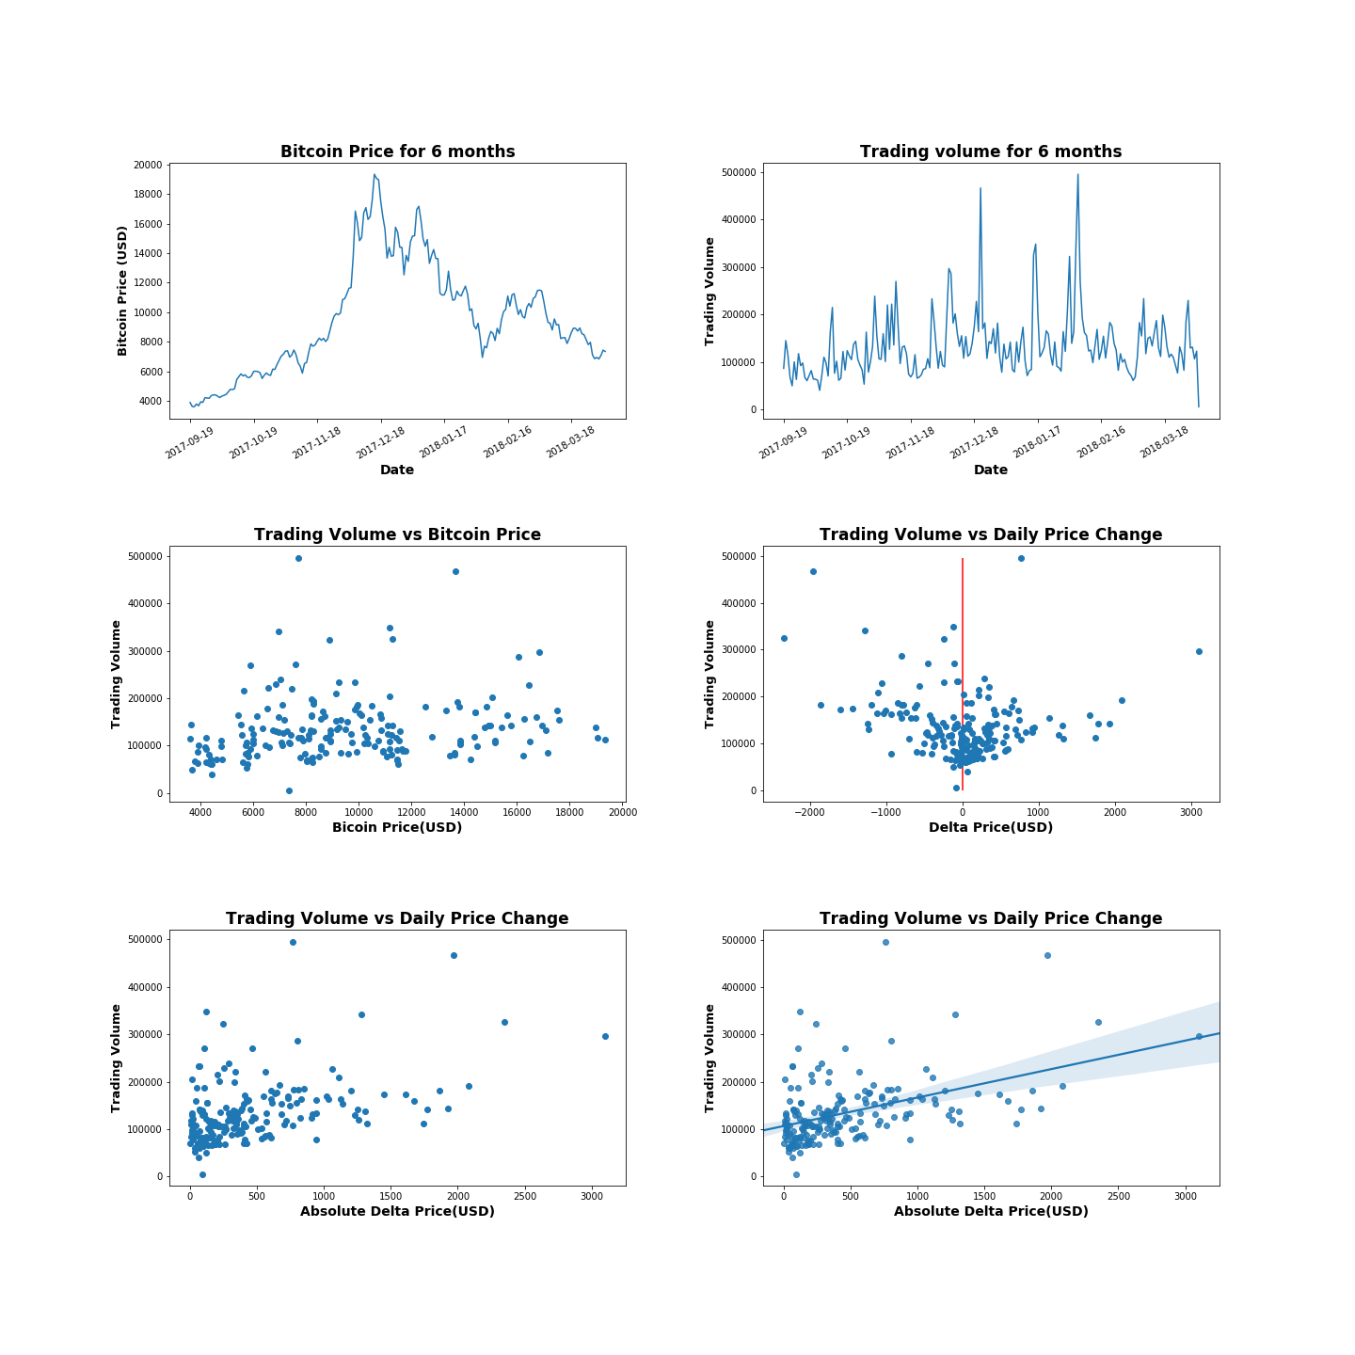
Bitcoin Trading Volume versus Price Analysis
Trading frequency was higher under $ 12,000 than over the value.
Most of the transactions (99.5% of Total Trading Volume) took place below $ 1,000 change.
The larger Bitcoin Price Change, the larger Trading Volume.

Slide 10
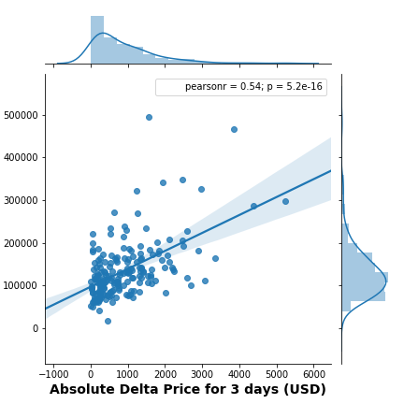
Bitcoin Daily Analysis
Looking at the change in the bit coin trading volume with the price change for one day to 7 days, The trading volume with the price change for 3 days has the greatest positive correlation. (r = 0.54, p = 5.2e-16)
People tend to stay in trading for three days against the Bitcoin price fluctuations.

Slide 11
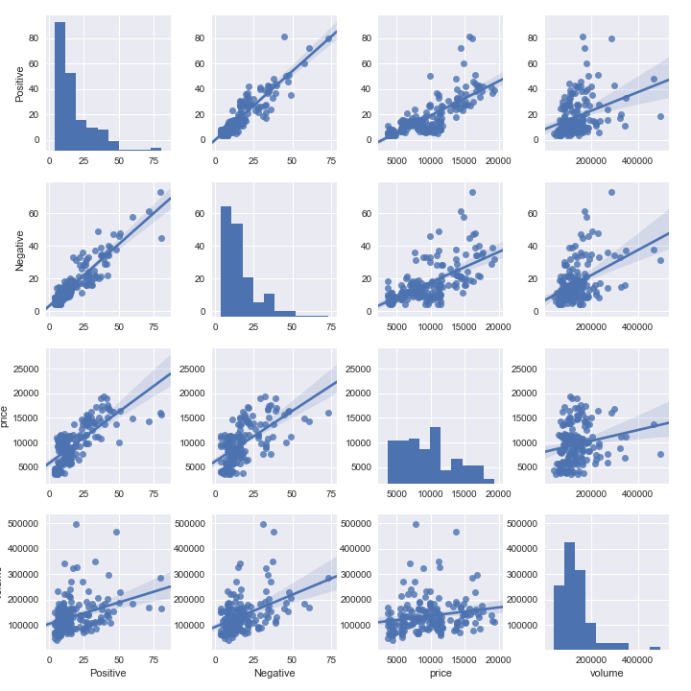
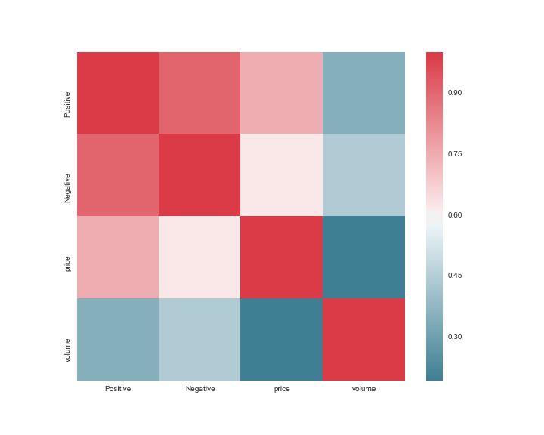
Heat Map

Slide 12
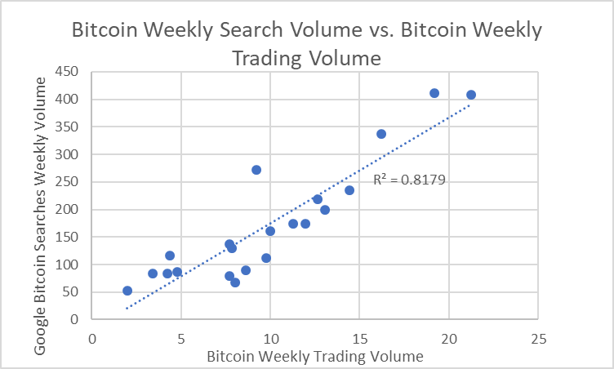
We found a very strong correlation between weekly search volumes for bitcoin and weekly trading volumes of bitcoin

Slide 13
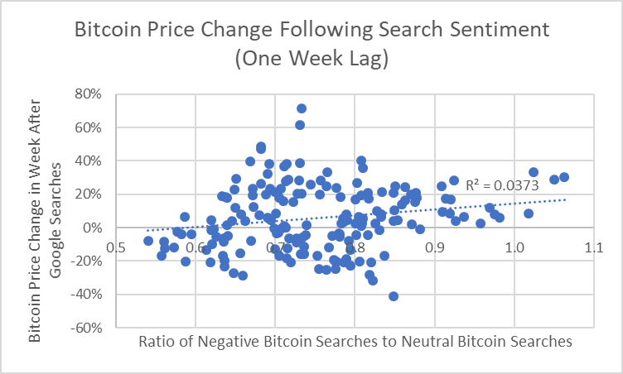
We found a weak correlation between our negative sentiment indicator and subsequent change in bitcoin price

Slide 14
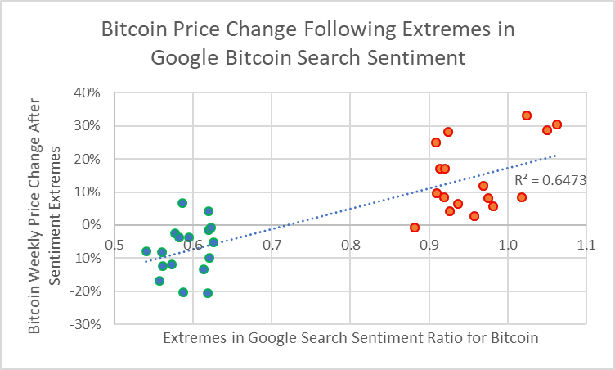
When we focused in only on extremes in our in negative sentiment indicator (top and bottom 10% of sentiment extremes), the predictive power of our indicator improved

Slide 15
Negative sentiment in Google searches appears to be inversely correlated with subsequent price moves in bitcoin. “Be Fearful When Others Are Greedy and Greedy When Others Are Fearful” -- Warren Buffet

Slide 16
Conclusion
Trading volume and Google “bitcoin” search volumes are highly correlated
It may be possible to create a Google Trends search sentiment analyzer which is similar to the Vader sentiment for text analysis
With (much) deeper analysis, it may be possible to predict future price movements in bitcoin based on Google Trends sentiment analysis

